Slide 1


Computer Organization & Architecture
Chapter 16
Micro-programmed Control

Slide 2
Introduction
The methods that control execution of an instruction:
  Hardwired control
    Inflexible
    It is difficult to add a new machine instruction
  Microprogrammed control
    Quite common in contemporary CISC
Microprogrammed control
  Control logic is specified by a microprogram
Microprogram
  A sequence of instructions in a microprogramming language
  Very simple instructions that specify micro-operations

Slide 3
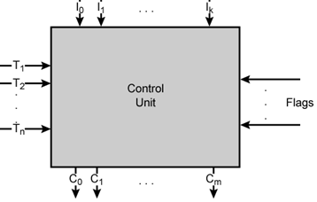
17.1 Basic Concepts
Microprogramming language
  A language Specifying micro-operations
  A clause is a microinstruction which is a binary symbol to describe a group of micro operations that can be executed in parallel
Microprogram
  A sequence of microinstructions
  Also called firmware
Firmware
  The program instructions in a read-only storage
  A midway between hardware and software
Control word
  A “0,1” sequence for control usage,
  corresponds a micro-operation

Slide 4
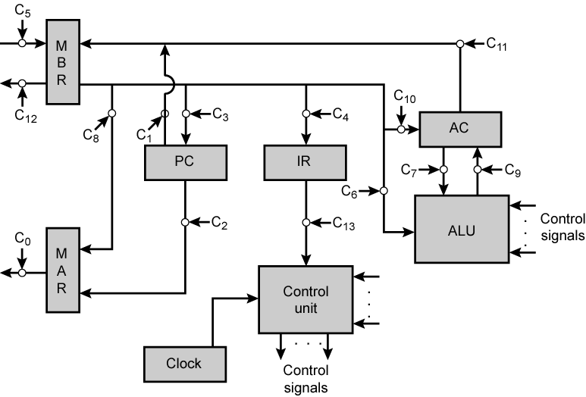
Data Paths and Control Signal
Data
bus
Address
bus
ADD X
（X）+AC－>AC

Slide 5
How to Control Using Microprogram
  All the control unit does is to generate a set of control signals
  Each control signal is on or off
  Represent each control signal by a bit
  Have a control word for each micro-operation
  Have a sequence of control words for each machine code instruction
  Add an address to specify the next micro-instruction, depending on conditions
  Also, add a few bits to specify the condition

Slide 6
Micro-instruction Types
  Each micro-instruction specifies single (or few) micro-operations to be performed
    (vertical micro-instruction)
  Each micro-instruction specifies many different micro-operations to be performed in parallel
    (horizontal micro- instruction)

Slide 7
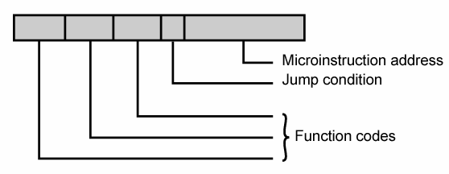
Vertical Micro-instruction
  Width is narrow
  n control signals encoded into log₂ n bits
  Limited ability to express parallelism
  seldom use

Slide 8
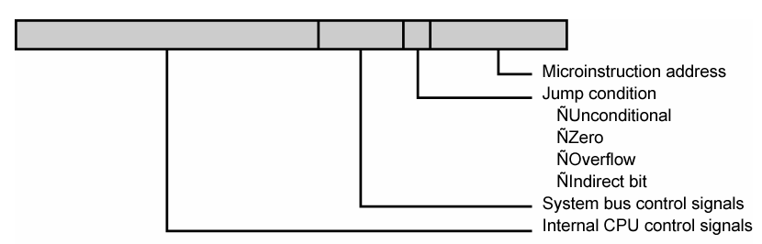
Horizontal Micro-instruction
  Wide memory word
  High degree of parallel operations possible
  Little encoding of control information

Slide 9
Interpretation of A Microinstruction
  This microinstruction turns on all the control lines indicated by a 1 bit, leaves off all the control lines indicated by a 0 bit
    The resulted control signals will cause one or more micro-operations to be performed
  If the condition indicated by the condition bits is 0, execute the next microinstruction in sequence
  If the condition indicated by the condition bits is true, the next microinstruction to be executed is indicated in the address field

Slide 10
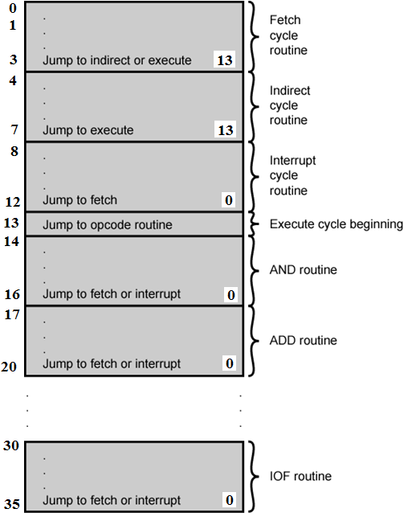
Organization of
Control Memory

Slide 11
Specifications
  Fig.17.2 presents the sequence of micro-operations to be performed during each cycle
    Fetch
    Indirect
    Execute
    interrupt
  Each stage is interpreted by a routine consisted of a segment of microinstructions
  The microinstructions in each routine are to be executed sequentially, at the end, with a branch or jump microinstruction indicating where to go next

Slide 12
Control Unit
  The control memory of Fig17.2 contains a program that describes the behavior of the control unit
  Fig17.3 shows the key elements of the control unit
    Control memory
    Control address register
    Control buffer register
    Sequencing unit

Slide 13
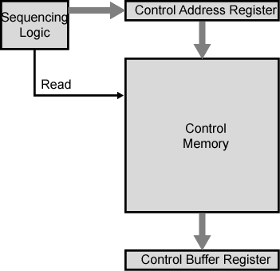
Control Unit Microarchitecture

Slide 14
Control Unit Function
  Sequence login unit issues read command
  Word specified in control address register is read into control buffer register
  Control buffer register contents generates control signals and next address information
  Sequence login loads new address into control buffer register based on next address information from control buffer register and ALU flags
  All this should happens in one clock pulse

Slide 15
Next Address Decision
  Depending on ALU flags and control buffer register
    Get next instruction
      Add 1 to control address register
    Jump to new routine based on jump microinstruction
      Load address field of control buffer register into control address register
    Jump to machine instruction routine
      Load control address register based on opcode in IR

Slide 16
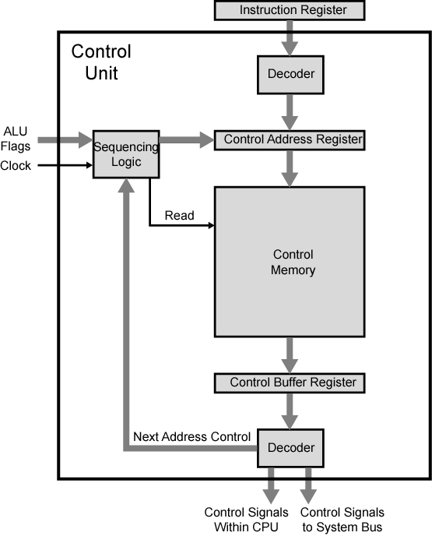
Functioning of Control Unit

Slide 17
Two decoders
  The upper decoder translates the opcode of the IR into a control memory address
  The lower decoder gives out control signals
    Just for vertical microinstruction implement

Slide 18
Advantages and Disadvantages
  Simplifies design of control unit
    Cheaper
    Less error-prone
  Slower than hardwired control
  Microprogramming is the dominant technique for implementing control unit in contemporary CISC
  Hardwired control is mainly used in RISC

Slide 19
17.2 Microinstruction sequencing
Tasks of microprogrammed control unit
  Microinstruction sequencing
  Microinstruction execution
  These tasks must be considered both together in designing the control unit

Slide 20
Design Considerations for microinstruction sequencing
  Size of microinstructions
  Address generation time
  How to obtain the next microinstruction
    Determined by instruction register
      Once per cycle, after instruction is fetched
    Next sequential address
      Common in most designed
    Branches
      Both conditional and unconditional
      Typically, one out of every 3~4 microinstructions could be a branches

Slide 21
17.3 Microinstruction Execution
The microinstruction cycle is the basic event
Each cycle is made up of two parts
  Fetch
    Determined by generation of microinstruction address
  Execute
    To generate control signals
    Some control points internal to processor, rest goes to external control bus or other interface
  Execute == READ

Slide 22
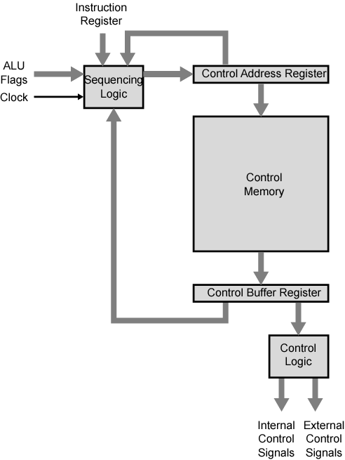
Control Unit Organization
+1

Slide 23
Applications of Microprogramming
Current applications include:
  Realization of computers
  Emulation
    Use of a microprogram on one machine to execute program originally written for another
  OS support
    Implement primitives
  Realization of special purpose devices
  High level language support
    Functions and data types implemented in firmware
  Micro-diagnostics
    Monitoring, detection,isolation, repair of system errors
  User tailoring
    Some machines provide a writable store and an easy-to-use microinstruction set to allow the user to write microprogram
Notes:
Imitation or representation, as of a potential situation or in experimental testing

Slide 24
Key points
  Concepts
    Microinstruction
    Microprogram
    Firmware
    Control word
  Key elements of the control unit
  Where does address of control memory come from?
  Basic tasks of microprogrammed control unit
  Applications of microprogramming

